Slide 1


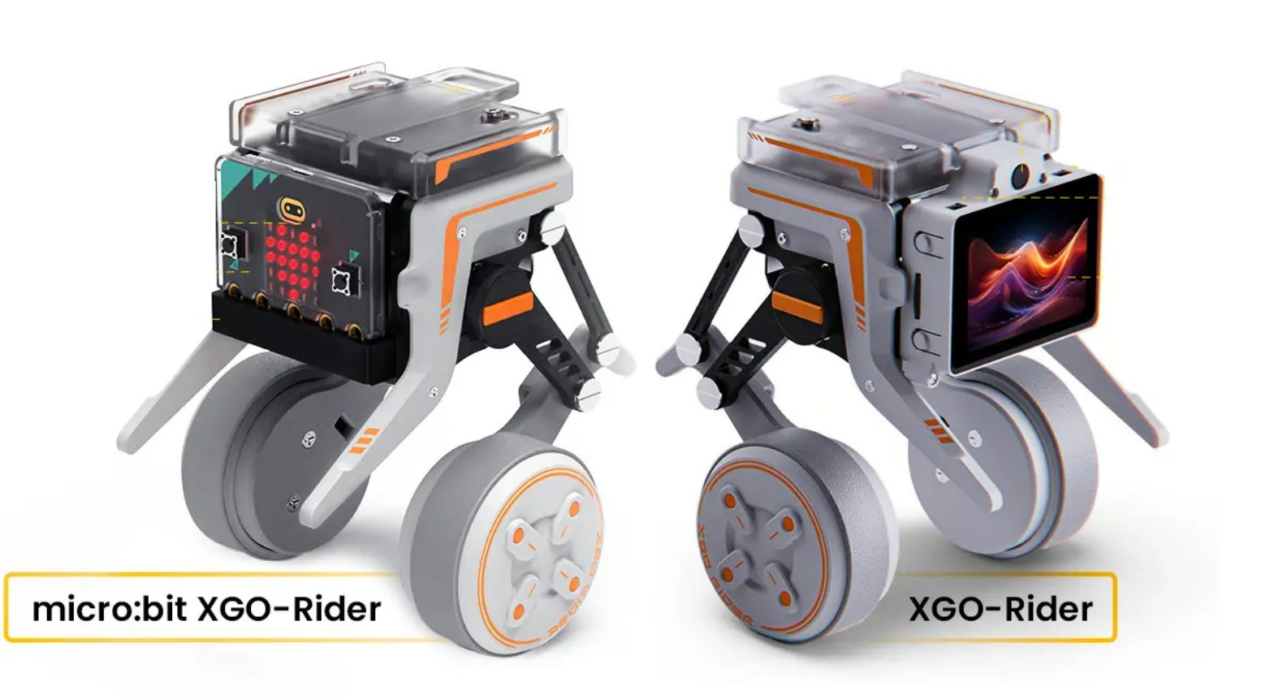




Raspberry Pi + ESP32 Robot
withLive Video Streaming&AI-based Control
ESP32
Live Streaming
AI Control
Robotics
2025-09-19

Slide 2















System Overview
Three-component architecture with specialized roles and interconnected communication methods.
Windows PC
Raspberry Pi
ESP32
AI Decision-Making
Network & Command Relay
Low-Level Hardware Control
Runs AI model
Streams video to PC
Motor control
Processes video streams
Relays commands to ESP32
Sensor data acquisition
Makes movement decisions
Manages network communications
Real-time obstacle avoidance
MJPG Stream
HTTP Commands
UART Communication
* Using ESP32 instead of Arduino Nano for enhanced Wi-Fi and Bluetooth capabilities

Slide 3











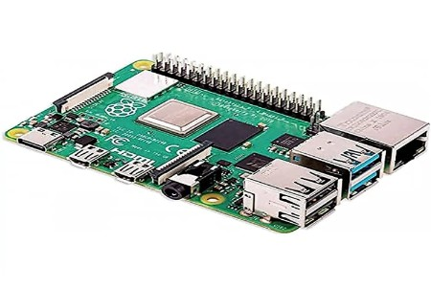
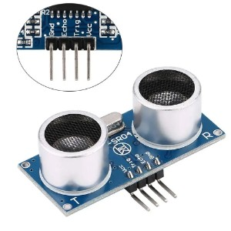
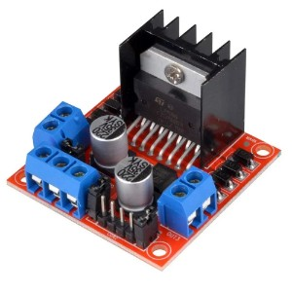
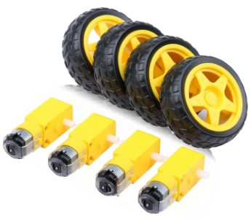
Hardware Components
Key hardware components for the Raspberry Pi + ESP32 robot system
Core Controllers
Sensors
Motors & Power
Raspberry Pi 4 (4GB RAM)
USB Webcam
Motor Driver (L298N/TB6612)
High-level processing for video streaming and network
Captures live video for streaming
Interfaces between ESP32 and DC motors
Ultrasonic Sensor (HC-SR04)
Voltage Divider for UART
ESP32
Measures distances for obstacle avoidance
Ensures safe communication between ESP32 and Pi
Real-time, low-level control with Wi-Fi/BT capabilities
Raspberry Pi 4
HC-SR04 Ultrasonic
L298N Motor Driver
DC Motors & Wheels

Slide 4







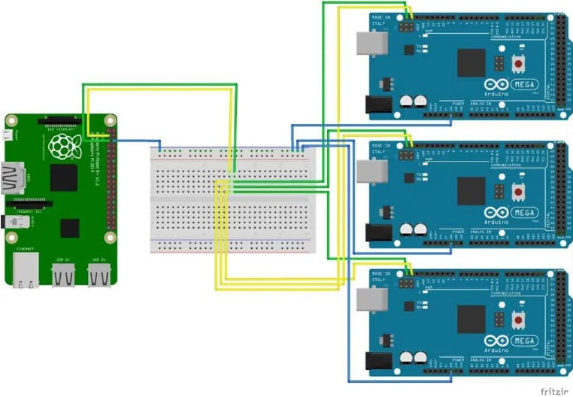



Circuit Connections
Establishing reliable communication between Raspberry Pi and ESP32 is crucial for robot operation.
UART Communication
Voltage Compatibility
Connection Scheme:
Raspberry Pi: 3.3V logic levels
ESP32 TX → Raspberry Pi RX
ESP32: 3.3V or 5V operation
ESP32 RX → Raspberry Pi TX
Voltage Mismatch:Use voltage divider or logic level shifter
Communication Flow:
Commands from PC → ESP32 via UART
Sensor data from ESP32 → Raspberry Pi
Common Ground Connections
Essential for:
Proper signal integrity
Preventing erratic behavior
Connecting GND pins of all modules
Example: Raspberry Pi with multiple Arduino boards via UART

Slide 5


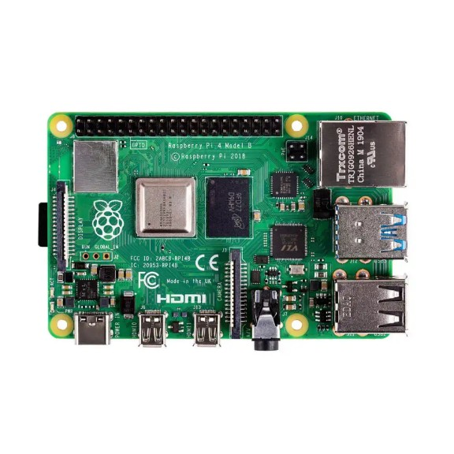
Software Setup (Pi)
MJPG-Streamer
Captures video from USB webcam and streams over network
# Stream URL:
http://<Pi_IP>:8080/?action=stream
Configuring the Raspberry Pi as the central hub for video streaming and command relay

Slide 6

















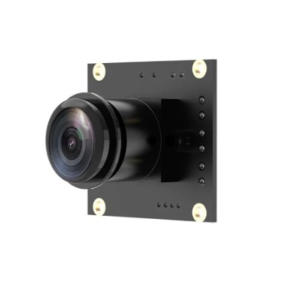

Video Streaming
MJPG-Streamer implementation for Raspberry Pi to capture and stream video for AI processing.
Video Source
Raspberry Pi
Network
Destination
USB Webcam
MJPG-Streamer
Wi-Fi Streaming
PC/AI Processing
Configuration Settings
Access Methods
Resolution
Web Browser
VLC
640x480 pixels
Direct access
Media player
Frame Rate
OpenCV
Mobile
20fps
AI processing
Remote viewing
Stream URL
http://<Raspberry_Pi_IP>:8080/?action=stream

Slide 7


















Command Handling
Flask server on Raspberry Pi receives and processes control commands for the ESP32.
Windows PC
Raspberry Pi
ESP32
AI Decision-Making
Flask Server
Motor Control
Sends HTTP POST requests
HTTP
UART
Forwards via UART
Sends status back
Flask Server Implementation
Security & Feedback
/move endpoint:Receives POST requests with movement commands
Token Authentication:Secure command execution
/status endpoint:Displays feedback from ESP32
Command mapping:Translates commands to simple codes (F/B/L/R/S)
Real-time feedback:System status and sensor data
PySerial:Forwards commands to ESP32 via UART

Slide 8




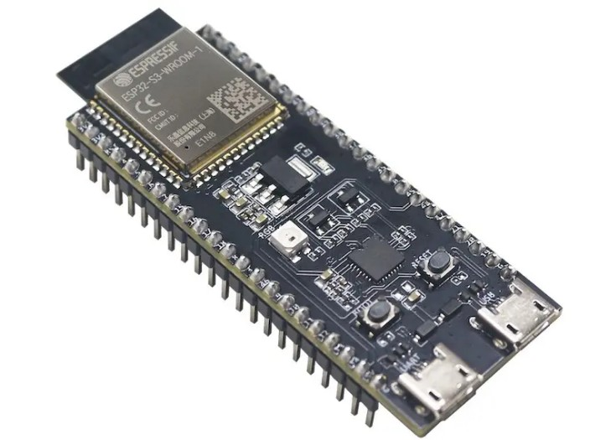






ESP32 Logic
UART Command Listening
Motor Control
Continuously monitors UART interface
Controls DC motors via L298N/TB6612 driver
Receives single-character commands (F/B/L/R/S)
Executes movement commands
Interfaces with Raspberry Pi via TX/RX
Handles forward/backward directions
Ultrasonic Obstacle Avoidance
Feedback to Raspberry Pi
ESP32 Role
Monitors distance using HC-SR04 sensor
Sends status information via UART
The ESP32 functions as the real-time control unit, handling low-level hardware interactions and time-critical operations.
Overrides commands if obstacle detected
Provides obstacle distance data
Prevents collisions at critical distances
Enables PC-side monitoring
Process Flow:ESP32 receives commands → executes motor actions → monitors obstacles → sends feedback

Slide 9









Windows PC (AI Side)
The Windows PC hosts the AI model and serves as the decision-making center for the robot.
OpenCV
AI Model
HTTP Requests
Captures MJPG video stream from Raspberry Pi
Analyzes video frames to make decisions
Sends commands to Raspberry Pi
HTTP POST requests
Real-time frame grabbing
Object recognition
Command translation (F/B/L/R/S)
Processing for AI analysis
Movement planning
Example Implementation
OpenCV Video Capture
cap = cv2.VideoCapture('http://pi:8080/stream')

Slide 10










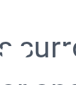




Workflow
Closed-loop operation integrating video streaming, AI-driven decision-making, and real-time motor control.
Video Streaming
AI Decision-Making
Raspberry Pi streams live video over Wi-Fi using MJPG-Streamer.
Windows PC processes video frames and makes movement decisions.
Obstacle Avoidance
ESP32 monitors surroundings with ultrasonic sensor and autonomously avoids obstacles.
Command Transmission
UART Forwarding
PC sends HTTP POST requests with movement commands to Raspberry Pi.
Raspberry Pi forwards commands via UART to ESP32.
* System continuously loops, enabling dynamic and intelligent robot navigation

Slide 11















Benefits & Extensions
Project Benefits
Future Extensions
Clean Division of Labor
H.264 Streaming
Raspberry Pi handles high-level tasks while ESP32 manages low-level, time-critical operations.
Transition from MJPG to H.264 for improved compression, reduced bandwidth, and higher quality video.
Scalability
ROS Integration
Modular design allows easy expansion with additional sensors, cameras, or AI features.
Integrate Robot Operating System for sophisticated navigation, task planning, and sensor fusion.
Cost-Effectiveness
Cloud AI
Affordable hardware provides accessible entry into robotics and AI for education and hobbyists.
Deploy AI model to cloud for greater computational resources, enabling more advanced algorithms.
Robustness
Additional Sensors
ESP32's independent obstacle avoidance provides safety even if AI or Raspberry Pi communication fails.
Add LiDAR, depth cameras, or IMUs for richer environmental understanding and enhanced autonomy.

Slide 12








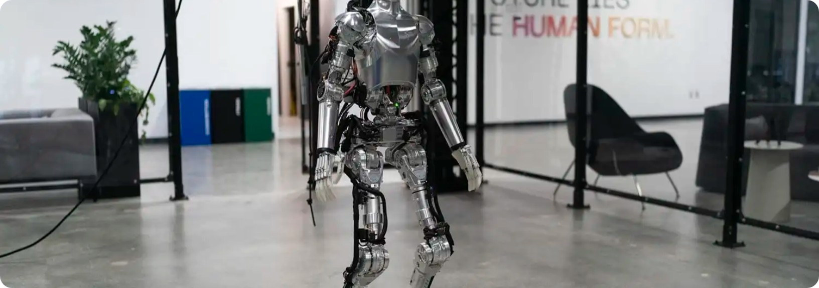


Conclusion
Project Achievements
Core Principles Demonstrated
This project successfully demonstrates anaffordable and integrated robotics platform, effectively combining:
IoT
Edge Computing
Connected device ecosystem with Raspberry Pi as an edge gateway
Data processing at the network edge with Raspberry Pi and ESP32
Live video streaming with MJPG-Streamer
AI-based decision-making from Windows PC
Real-time motor control with ESP32
Robotics Control
Integration
Autonomous obstacle avoidance capabilities
Hierarchical control system with PC, Raspberry Pi, and ESP32
Modular architecture for easy expansion and future development
Next Steps
This project provides a robust foundation for further experimentation:
Enhance with H.264 streaming
Integrate with ROS for navigation
Deploy AI to cloud platforms

